Slide 1
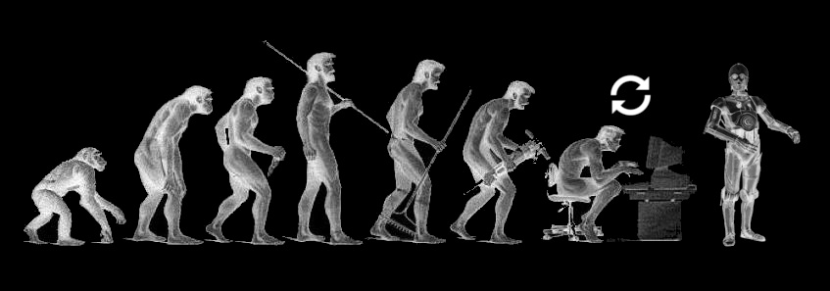
Journey towards AI world…

Slide 2
AI applications

Slide 3
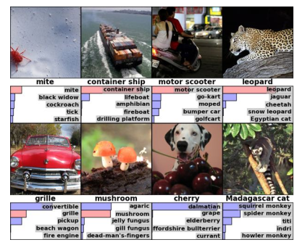
Object Recognition

Slide 4
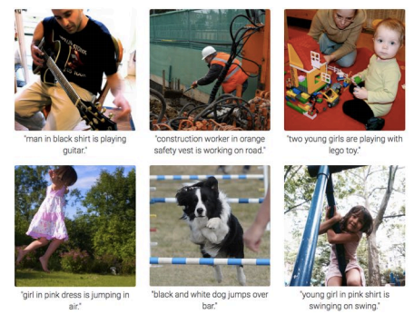
Image Captioning

Slide 5
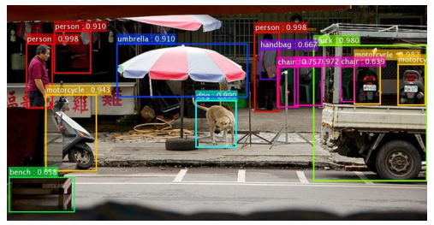
Object Detection

Slide 6
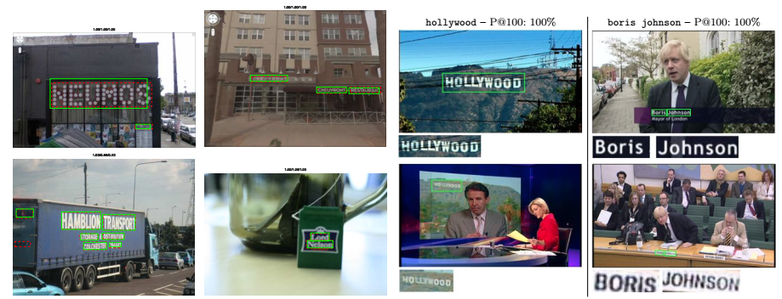
Text detection and retrieval

Slide 7
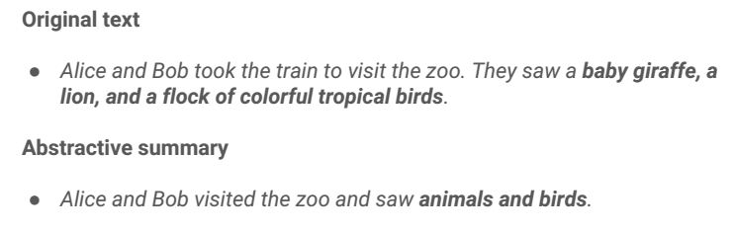
Text Summarization

Slide 8
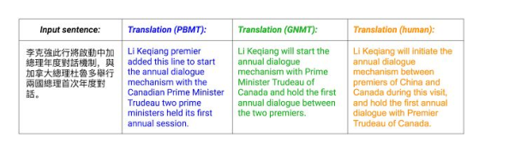
Text Translation

Slide 9
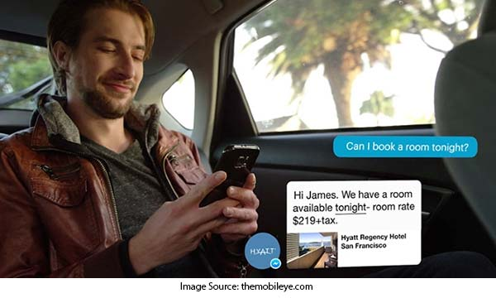
bots use case

Slide 10
More applications
http://www.yaronhadad.com/deep-learning-most-amazing-applications/

Slide 11
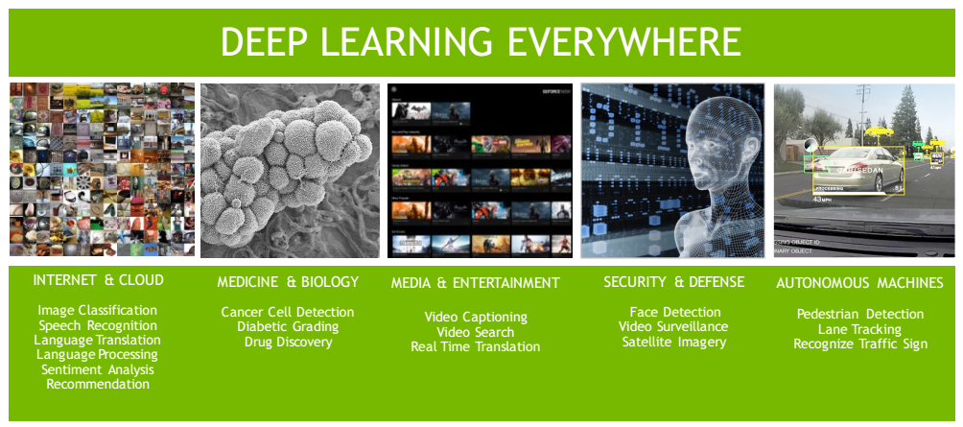

Slide 12
What is deep machine learning(DL)?

Slide 13
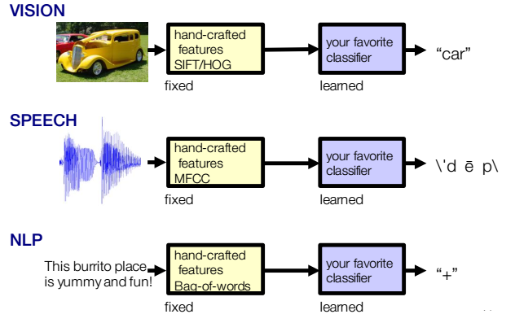
Traditional ML

Slide 14
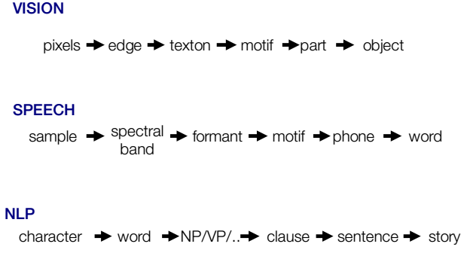
How can we automate the feature extraction?
Most important discovery: Human brain understands the unstructured data by using hierarchical representations

Slide 15
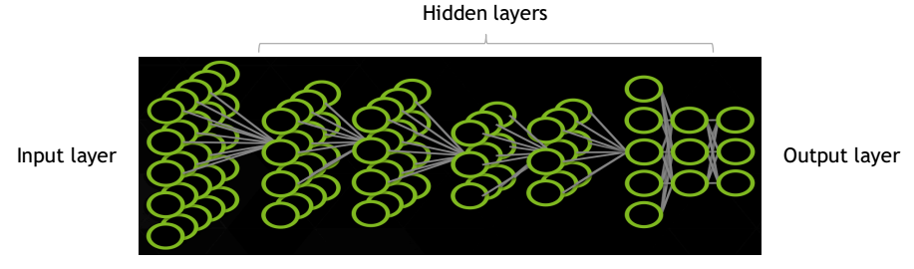
Deep neural networks
Neural networks inspired from human brain could be used to automate feature extraction of unstructured data. Neural networks with more than three levels of depth are called as deep networks.

Slide 16
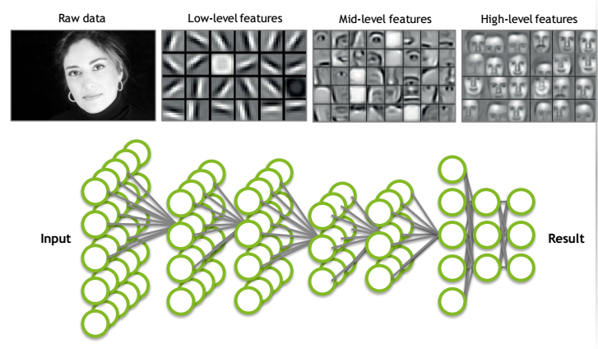
Deep Learning Algorithms
Deep learning algorithms allows the deep neural networks to learn multiple levels of abstraction (i.e., hierarchical features) on unstructured data formats automatically.

Slide 17
Why Neural Network models?
Neural network models could be used for automatic pattern recognition:
Classification
Regression
Dimensionality Reduction
Word embeddings

Slide 18
Why Neural Network models?
Neural network models could be used to extract features automatically
Feature extractors from image/speech data
Feature extractors from sequence data like text/timeseries
Neural network model learning could be scaled well
Most mining tasks involve big datasets and stochastic gradient learning algorithm can handle the learning task over big datasets

Slide 19
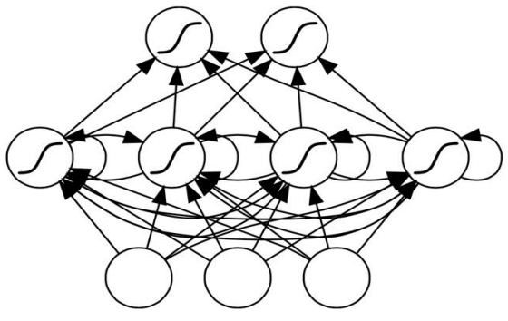
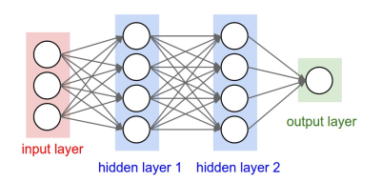
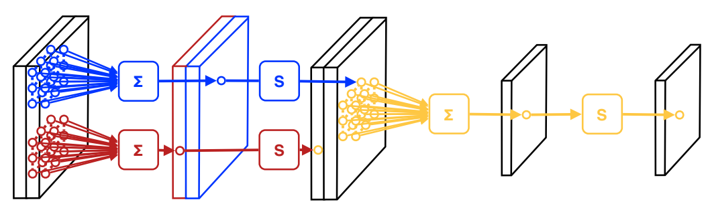
Most common deep neural networks
Recurrent Neural Network(RNN)
Feed Forward Neural Network(FFNN)
Convolutional Neural Network(CNN)

Slide 20
Benefits of Deep Learning

Slide 21
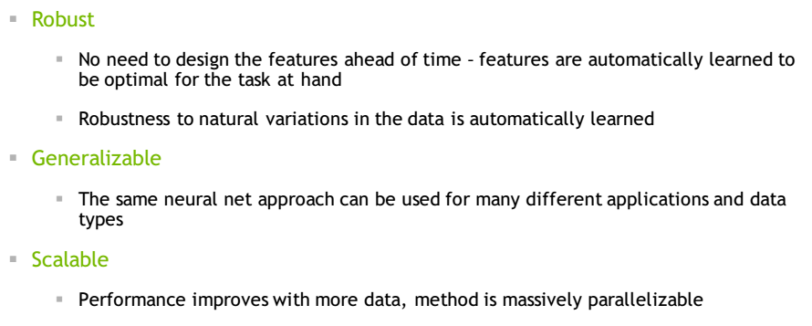
Benefits of Deep Machine Learning

Slide 22
The role of AI(data) scientist

Slide 23
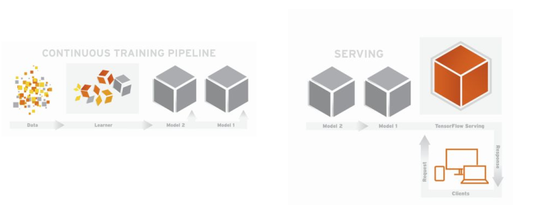
Role of data scientist
Data scientist must build those networks and fine tune those networks based on the problem
Must take care of entire data analysis pipeline implementation and serving version of models for client applications

Slide 24
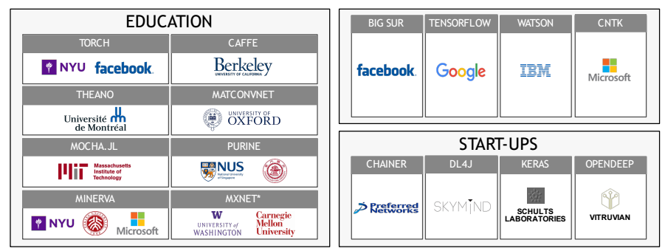
The Engines for Modern AI
How can a datascientist build such deep learning networks?

Slide 25
Where do you deploy them?

Slide 26
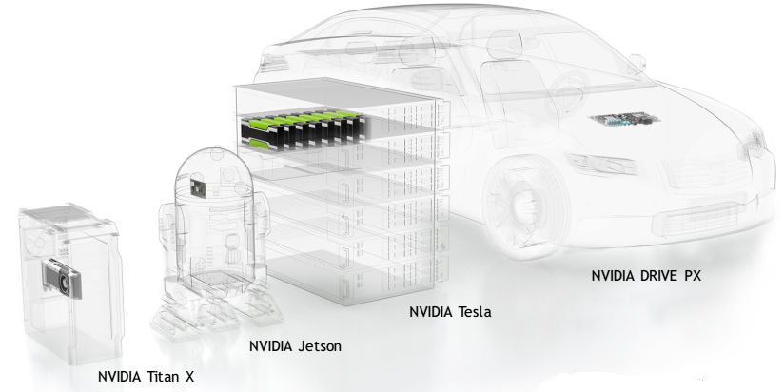
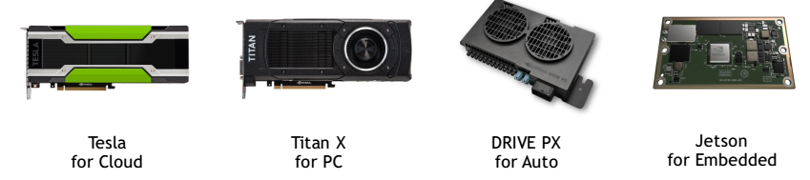
AI in Action

